Slide 1
CS 4530: Fundamentals of Software Engineering Lecture 3: Code-Level Design Principles
Jonathan Bell, Adeel Bhutta, Mitch Wand
Khoury College of Computer Sciences
© 2022 Released under the CC BY-SA license

Slide 2
Learning Objectives for this Lesson
By the end of this lesson you should be able to:
Describe the purpose of our design principles
List 5 code-level design principles with examples
Identify some violations of the principles and suggest ways to mitigate them
Notes:
<Read Slide>

Slide 3
Good code is comprehensible by humans
Which humans?
The other members of your team
The folks who will maintain and modify your system
Management
Your clients
and ...
You, a week from now or 6 weeks from now

Slide 4

Bad code is hard to comprehend
function calculateFoo(x: number, y: number, increment: boolean): number {
if (increment)
x++;
x *= 2;
x += y;
return x;
}
calculateFoo(3, 5, true) = ? calculateFoo(3, 5, false) = ?
13
8
11
Notes:
<Ask students what return values are>
Click 1: see first answer
Click 2: see common wrong answer for second call.
Click 3: Show correct wrong answer
This is an example of code that is hard to understand, due to syntax: had there been curly braces around the code controlled by the if statement (line 3), and had line 4 been indented to match lines 2 and 5, it would have been obvious what the function did.
This is an example of a bad design that can be easily solved by a linter, which can check for syntactic rules like this (and fix them!)

Slide 5
Bad code is hard to comprehend
function anotherExample(value: number): void {
switch (value) {
case 1:
doSomething();
case 2:
doSomethingElse();
break;
default:
doDefaultThing();
}
}
Notes:
Here’s another: What function gets called if the value is 1? (doSomething and doSomethignElse)
This is also somewhat confusing, because the case statement on line 3 will also execute line 6 because there is no “break” in the switch statement, and the semantics of switch statements is that if there is no break, the execution continues.
Rules on switch/case and break statements can also be automatically enforced by linters.
However, this is not a lecture about confusing syntax: we will rely on a linter to avoid these confusing patterns.
What are the qualities that make for ”well-designed” code?

Slide 6
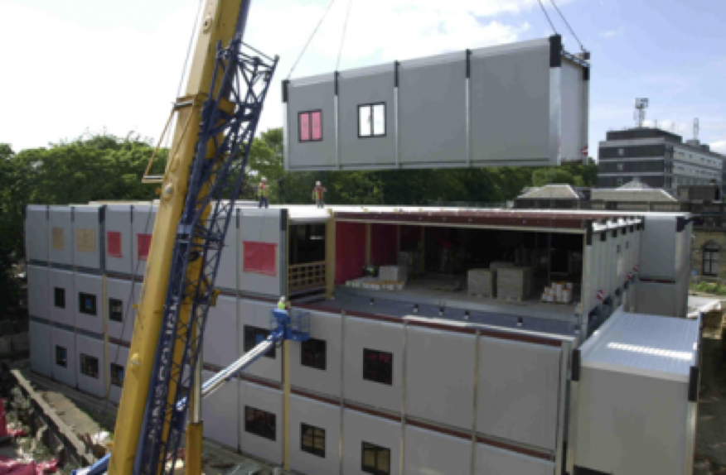
Good code is designed for reuse
Modern applications are assembled from existing code
External dependencies
Internal APIs that get reused
Copy/paste ☹
Intentional design is key to enabling effective reuse
Notes:
Good code should not only be easy to comprehend, but ideally also easy to reuse. <read slide>

Slide 7
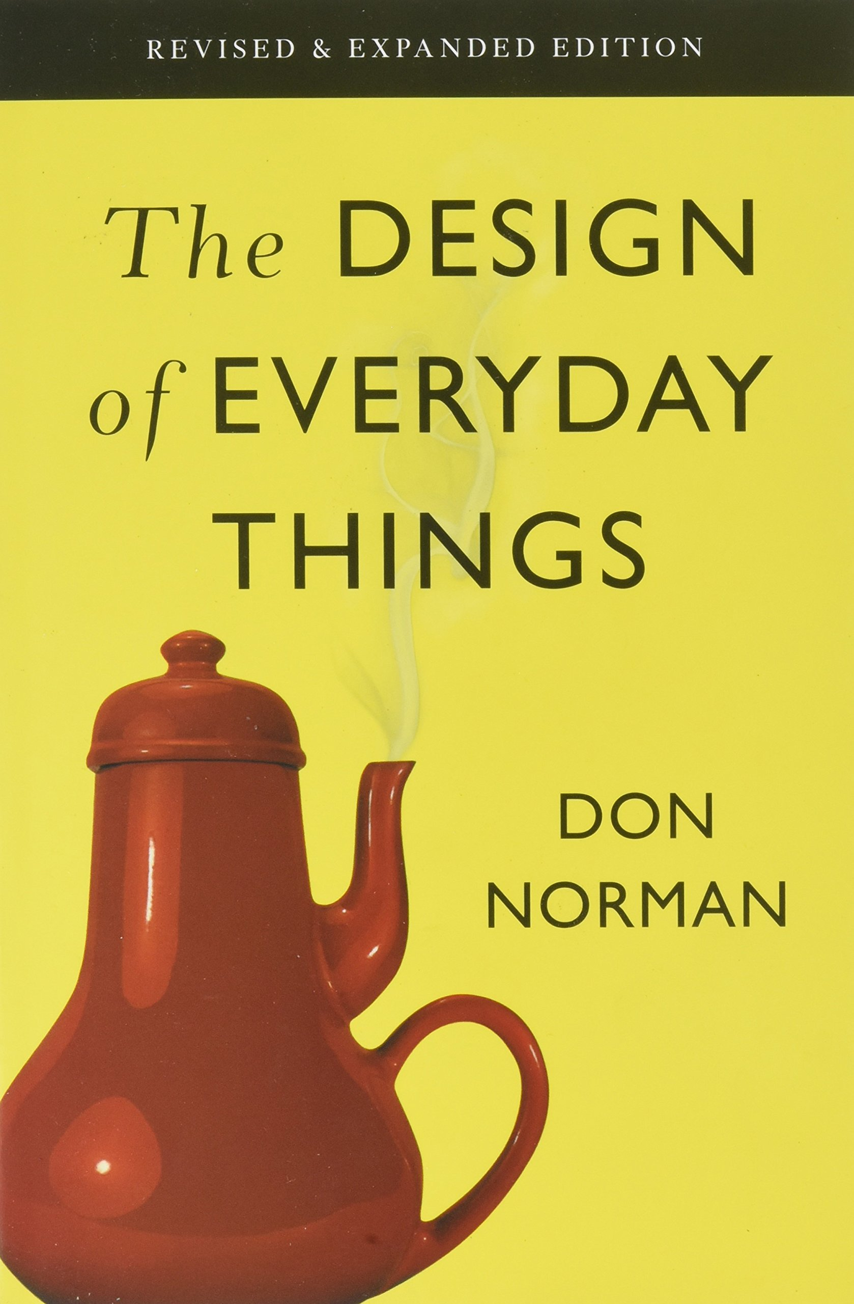
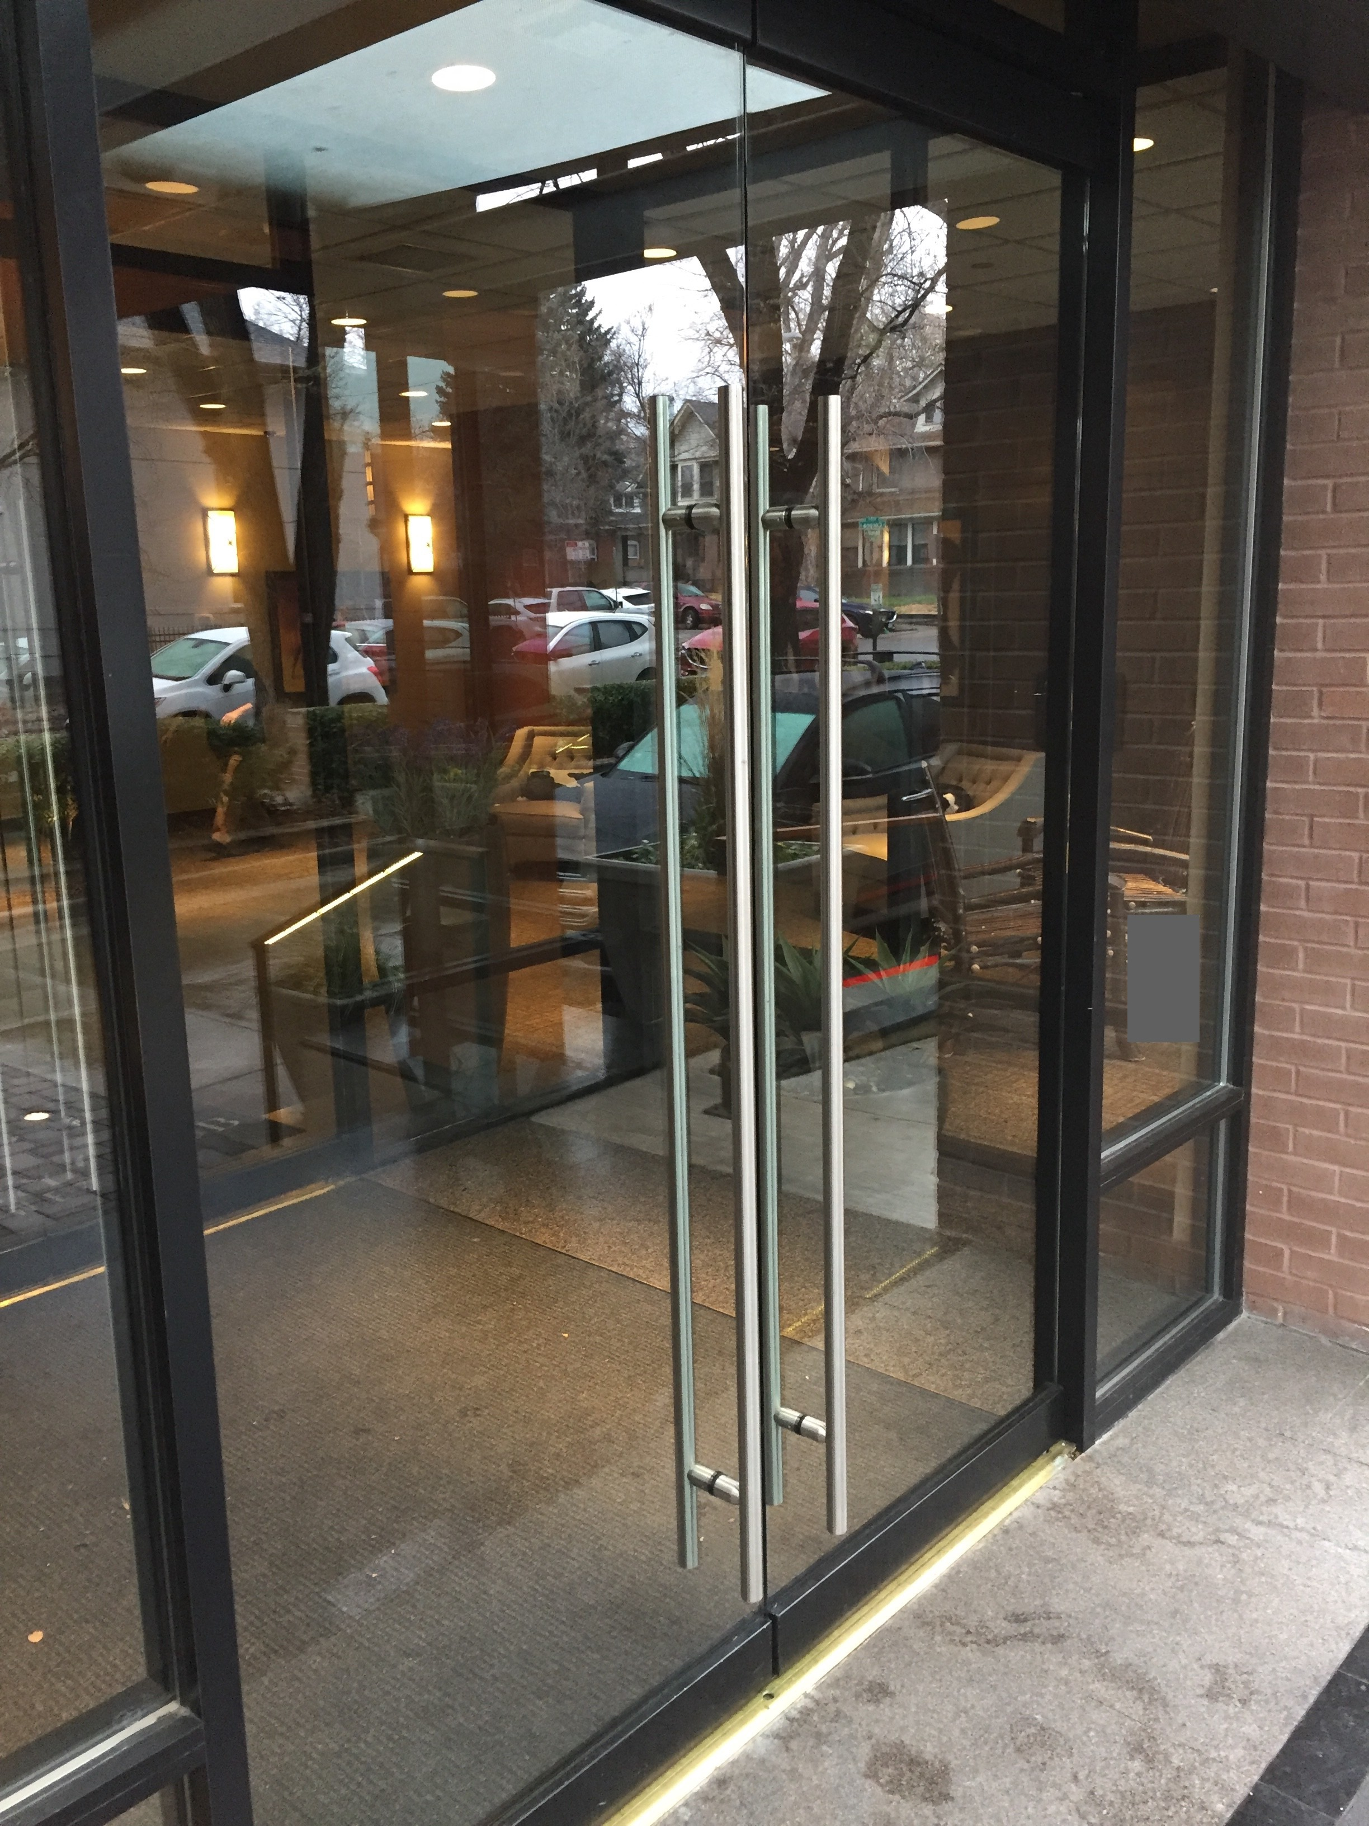
Good code is “usable” by developers
Notes:
One way to capture this idea of “easy to comprehend” is to look at design research, and in particular, the goal of creating *usable* designs.
In “The design of everyday things”, Don Norman describes what makes designs usable.
Norman provides doors as an example: typically, a handle like this indicates that you should pull on the handle to open the door.
(Click to build) Note that both sides of the door has the same kind of handle. However, if the door swings only one way, it is not immediately evident to a user of the door what they should do with it. This door is not as usable as one that uses different kind of handles to indicate how the user should interact with the door (push v pull)
How can code be “usable”? Consider the ways that developers interact with code: fixing bugs, extending it, reusing it – usable code is code that developers can efficiently and effectively developers can perform these tasks.

Slide 8
Use Design to Control Complexity
Software systems must be comprehensible by humans
Why? Software needs to be maintainable
continuously adapted to a changing environment
Maintenance takes 50–80% of the cost
Why? Software needs to be reusable
Economics: cheaper to reuse than rewrite!
8
Notes:
<Read Slide>

Slide 9
Three Scales of Design
The Structural Scale
key questions: what are the pieces? how do they fit together to form a coherent whole?
The Interaction Scale
key questions: how do the pieces interact? how are they related?
The Code Scale
key question: how can I make the actual code easy to test, understand, and modify?

Slide 10
Today’s topic: design principles at the code scale
Design at the interaction scale: next topic
Design at the architecture scale: in a few weeks

Slide 11
Coupling is the biggest source of complexity at the code level
Two pieces of code are coupled if a change in one demands a change in the other.
A coupling represents an agreement between the two pieces of code.
They may agree on:
names
order (e.g. of arguments)
meaning (e.g. meaning of data)
algorithms
The more two pieces of code are coupled, the harder they are to understand and modify: you have to understand both to understand either of them.
There's a fancy word for this: connascence (meaning "born together")
More coupling means less readability, less modifiability
Notes:
<Read slide>

Slide 12
Five general-purpose design principles
Five General Principles
1. Use Good Names
2. Make Your Data Mean Something
3. One Method/One Job
4. Don't Repeat Yourself
5. Don't Hardcode Things That Are Likely To Change
Notes:
Here are five general-purpose principles that apply to just about all programming tasks. We’ve phrased this in terms of programming practices: things that you can do to make your code better.
I suggest that you make a sticky note with this list and keep it on your laptop screen or somewhere in your workspace so that you will be constantly reminded of it.

Slide 13
Principle 1. Use Good Names
The name of a thing is a first clue to the reader about what the thing means.
often, it's the only clue ☹
Use good names for
constants
variables
functions/methods
data types
Notes:
<Read Slide>

Slide 14

Use Good Names for Variables and Types
var t : number
var l : number
var temp : number
var loc : number
var temp : Temperature
var loc : SensorLocation
type Temperature = number
type SensorLocation= number
Notes:
What do these variables mean?
Better names would give the reader a clue
<click>
This is a little better. But does 'temp' mean 'temporary', or 'temperature', or something else?
<click>
Better names for the data types would be even better. We’ll say more about this in a minute, when we get to Principle 2: Make Your Data Mean Something

Slide 15
Use Good Names for Functions and Methods
function checkLine (line) : boolean
function LineIsTooLong (line) : boolean
Notes:
What are you checking it for? Length? Illegal Syntax? or what?
<click>
Ahh, now we know!

Slide 16
Use Good Names for Functions and Methods
Use noun-like names for functions or methods that return values, e.g.
not:
Reserve verb-like names for functions or methods that perform actions, like
let c = new Circle(initRadius)
let a = c.diameter()
let a = c.calculateDiameter()
table1.addItem(student1,grade1)
Notes:
In the real world, your workplace should have coding standards for things like this
This particular convention is part of Prof. Wand's personal coding practice. . You’ll see similar conventions in the names we chose for the functions in Homework 1.
When you work on your team project, you may want to decide about the coding conventions you will use.

Slide 17
Principle 2. Make Your Data Mean Something
You need to do three things:
Decide what part of the information in the "real world" needs to be represented as data
Decide how that information needs to be represented as data
Document how to interpret the data in your computer as information about the real world
Notes:
“Make Your Data Mean Something” What does that mean? It means that when you design your data, you need to do three things: <read bullets>

Slide 18
Example:
Right now I am wearing a red shirt, and I've decided I need to represent that fact in my program.
How should I represent that in my program?
We need to decide:
how to represent shirts (including their color)
how to represent colors
how to represent my shirt
Notes:
<read slide>

Slide 19
We need to write something like this:
type Shirt = {
/** the color of the shirt */
color: Color
}
type Color = { ... }
/** My shirt */
const myShirt: Shirt
myShirt.color = red
Notes:
We need to define a type Shirt, which will be the data type that represent shirts. Inside that data type, there will be a field called color, and we need to record the fact that this field represents the color of the shirt.
We need to define a type Color, which will be the data type for representing colors.
And when we need to represent my shirt, we’ll define a variable myShirt, and we need to record the fact that this variable contains a representation of my shirt.

Slide 20
Gulf of Understanding: Interpretation and Representation
How do we know that these are connected?
Answer: we have to write it down.
In our Typescript infrastructure, we do that with the comments.
Good program design narrows the gap between interpretation and representation
representation
My shirt is red
type Shirt = {
/** the color of the shirt */
color: Color
} type Color = { ... }
/** My shirt */
const myShirt: Shirt
myShirt.color = red
interpretation
Notes:
Here’s the big picture. On the left, we have a fact about the real world: my shirt is red.
On the right, we see how that real-world fact is represented in our code.
We *represent* a real-world fact in code
We *interpret* the code as a real-world fact.
How do we know these are connected? We have to *write it down*.
Otherwise the next person who looks at this code won’t know what we meant.
In our Typescript system, we do that in the comments.

Slide 21
Bad Designs Have a Large Gap Between Interpretation and Representation
I should pull this to open it???
representation
interpretation
Adding a text label “Push” and “Pull” would serve to document the intended behavior
A better design might not even need that label

Slide 22
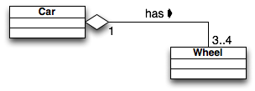
Another example: What does an object represent?
What does an object of class Car represent?
a model of car (e.g. Dodge, Ford, Toyota)?
a particular car (my 2019 Toyota, VIN = 456789)?
What does an object of class Wheel represent?
a model of tire? (Goodyear GoodGrips14)
a particular tire? (Goodyear GoodGrips14 SN = 345678)
What does "has" represent?
depends on what Car and Wheel represent
this may affect the navigability of the association
(can you get from a car object to the associated wheels? Can you get from a wheel to the car that it’s on?)
Notes:
Here’s another example.
<read slide, and click 3 times to view the whole animation>
Note that this UML diagram gives us some information about this: it says that each wheel object is “had” by exactly one car object.
But this is pretty well-hidden. It would have been helpful if the person who wrote this UML documented exactly what they meant..

Slide 23
Principle 3: One Method/One Job
Each class, and each method of that class, should have one job, and only one job
If your method has more than one job, split it into 2 methods. Why?
You might want one part but not the other
It's easier to test a method that has only one job
You call both of them if you need to.
or write a single method that calls them both
Same thing for classes.
Notes:
<Read slide>
The fancy name for this is "The Single Responsibility Principle". You can use this if you want to impress your coop interviewer.

Slide 24
Principle 4: Don't Repeat Yourself
If you have some quantity that you use more than once, give it a name and use the name.
That way you only need to change it in one place!
And of course you should use a good name
If you have some task that you do in many places, make it into a procedure.
If the tasks are slightly different, turn the differences into parameters.
Notes:
If you have some quantity that you use more than once, give it a name and use the name.
That way you only need to change it in one place!
If you have some task that you do in many places, make it into a procedure.
This is called "Single Point of Control"
And of course you should use a good name

Slide 25
A real example
describe('ConversationArea', () => {
const testAreaBox = { x: 100, y: 100, width: 100, height: 100 };
let testArea: ConversationArea;
const townEmitter = mock<TownEmitter>();
const topic = nanoid();
const id = nanoid();
let newPlayer: Player;
beforeEach(() => {
mockClear(townEmitter);
testArea = new ConversationArea({ topic, id,
occupantsByID: [] }, testAreaBox, townEmitter);
newPlayer = new Player(nanoid(), mock<TownEmitter>());
testArea.add(newPlayer);
})
Notes:
Here’s an actual example, from the covey.town codebase. There are quite a few tests for the ConverstaionArea class. However, all of them require creating some conversation area, and many of them involve adding some player to that conversation area. By putting these repeated steps in a “beforeEach”, we ensure that they run before each test. If we ever change the way that conversation areas are created, we can change all of the tests at once, by changing just this one location.

Slide 26
A real example
public nearbyPlayers() { const areTwoPlayersNearby = (p1: PlayerController, p2: PlayerController) => { if (p1.location.interactableID || p2.location.interactableID) { return p1.location.interactableID === p2.location.interactableID; } const dx = p1.location.x - p2.location.x; const dy = p1.location.y - p2.location.y; const d = Math.sqrt(dx * dx + dy * dy); return d < NEARBY_PLAYER_THRESHOLD; }; return this.players.filter(p => areTwoPlayersNearby(p, this.ourPlayer)); }
Notes:
Here’s an actual example, from the covey.town codebase. There are many aspects of the system that need to know which players are “Nearby” for the purposes of including in a video call. In the original implementation, this behavior was scattered throughout the codebase, and two players were considered “nearby” if the distance between their two centers was less than some threshold. Then, with the additional of “interactable areas”, the definition of “nearby” had to change, such that if either player is in an interactable area, they would be considered nearby iff they were both in the same interactable area.
Note that this method has a clear name that explains what it returns, and because it is returning something, the name is a noun (nearbyPlayers).
Note that this method also is somewhat self-documenting, separating the code that filters the players from the predicate that determines which players are nearby. Perhaps this is even an example of “one method one job”
This design could also make it cleaner to further refactor the “areTwoPlayersNearby” predicate into a method of PlayerController, in the event that it becomes necessary in the future

Slide 27
A real example
function testequal <T> (testname: string, actualVal: T, correctVal: T) {
test(testname,
function () { expect(actualVal).toBe(correctVal) })
}
describe('tests for countOfLocalMorks', function () {
testequal('empty crew',countOfLocalMorks(ship1),0)
testequal('just Mork',countOfLocalMorks(ship2),1)
testequal('just Mindy',countOfLocalMorks(ship3),0)
testequal('two Morks',countOfLocalMorks(ship4),2)
testequal('drone has no Morks',countOfLocalMorks(drone1),0)
})
Notes:
Here’s an actual example, from a couple of semesters ago, in Jest..
Think of how much typing this saves!
Plus, if I ever need to change what testequal does, I can do it all in one place.
Note: Jest has a built-in abstraction for this, called test.each , but that’s not the point of this example.

Slide 28
Principle 5: Don't Hardcode Things That Are Likely To Change
"No magic numbers" and "Don't Repeat Yourself" are already examples of this.
General strategy: If there something that might change, give it a name
if it's not already a "thing", refactor to make it a "thing“
Let’s look at a couple of examples.
Notes:
<read slide>

Slide 29
Replace magic numbers with good names
Replace magic numbers with good names
let salesprice = netPrice * 1.06
const salesTaxRate = 1.06
let salesPrice = netPrice * salesTaxRate
Notes:
Where did that 1.06 come from?
Oh, it's the sales tax? Are there many occurrences of that 1.06 in your code? (Probably!) Will the sales tax rate ever change? (Probably!)
Let's fix it!<click>

Slide 30
Example
Imagine we are computing income tax in a state where there are four rates:
One on incomes less than $10,000
One on incomes between $10,000 and $20,000
One on incomes between $20,000 and $50,000
One on incomes greater than $50,000
You might write something like
Notes:
<You can skip this example if you are worried about time>
Here’s another example:
<read slide>

Slide 31
You might write something like
What might change?
The boundaries of the tax brackets might change
The number of brackets might change
function grossTax(income: number): number {
if ((0 <= income) && (income <= 10000)) { return 0 }
else if ((10000 < income) && (income <= 20000))
{ return 0.10 * (income - 10000) }
else if ((20000 < income) && (income <= 50000))
{ return 1000 + 0.20 * (income - 20000) }
else { return 7000 + 0.25 * (income - 50000) }
}
Notes:
Here’s a possible piece of code.
Here we’ve hard-coded the information about the tax brackets.
But those might certainly change. What might change?
The boundaries of the tax brackets might change
The number of brackets might change.
This tells us that the notion of a “tax bracket” is an important concept.
But this concept is not explicit in the code we’re looking at– it’s hard-wired into the code.
So probably we should have a representation of “a tax bracket” as a piece of data.
And once we realize that “tax bracket” is an important concept, we can also see that this piece of code violates One Function/One Job:
It finds the appropriate bracket AND calculates the appropriate tax.

Slide 32
So let's represent our data differently
// defines the tax bracket for income lower < income <= upper.
// if upper is null, then lower < income (no upper bound)
type TaxBracket = {
lower: number,
upper: number | null,
base : number
rate : number
}
let brackets : TaxBracket[] = [
{lower:0, upper:10000, base:0, rate:0},
{lower:10000, upper:20000, base:0, rate:0.10},
{lower:20000, upper:50000, base:1000, rate:0.20},
{lower:50000, upper: null, base:7000, rate:0.25}
]
Notes:
So here’s a possible representation of a tax bracket. Note the comment on the first two lines, which tells us what a value of type TaxBracket means in the real world.
Among other things, we now have a single point of control if we ever need to change the brackets.

Slide 33
And now it's easy to rewrite our function
// defines the incomes covered by a bracket
function isInBracket(income:number, bracket:TaxBracket) : boolean {
if (bracket.upper == null)
{ return (bracket.lower <= income) }
else
{ return ((bracket.lower <= income) && (income < bracket.upper))}
}
function income2bracket(income: number, brackets: Bracket[]): Bracket {
return brackets.find(b0 => isInBracket(income, b0))
}
function taxByBracket(income:number,bracket:TaxBracket) : number {
return bracket.base + bracket.rate * (income - bracket.lower)
}
function grossTax2 (income:number, brackets: TaxBracket[] ) : number {
return taxByBracket(income,income2bracket(income,brackets))
}
Notes:
So here’s our rewritten code. And we are back to one function/one job.
Professor Wand says: “True story: My first draft of this code was quite different and had several bugs. I eventually located the bugs by rewriting the code with one function/one job. When I did that, it was easy to see which part was broken.”
What assumptions does income2bracket make about the list brackets? Hint: how could you define a bracket list that would break income2bracket? Where should we record these assumptions? Would it help to define a type called TaxBracketList ?

Slide 34
Review: Learning Objectives for this Lesson
You should now be able to:
Describe the purpose of our design principles
List 5 general design principles and illustrate their expression in code
Identify some violations of the principles and suggest ways to mitigate them

Slide 35
Additional Material

Slide 36
Examples of Design at the Structural Scale
Object-Oriented
Pipeline
Pipeline + Database
Layered
Notes:
<Cover if time>
This lesson has been about design at the code level. Here’s some brief introduction to the other two scales.
<read slide>

Slide 37
Object-Oriented Architecture
The entities in the program correspond to entities in the real world.
Example: a library system might have classes for
A holding (several books, eg: “7 copies of Moby-Dick”)
An individual item (“copy #3 of Moby-Dick”)
A card-holder (“Avery Fischer, library card #12345, …”)
A borrowing (“Avery Fischer borrowed copy #3 of Moby-Dick on 9/1/22”)
Notes:
Our first architectural style is the object-oriented architecture. In this architecture, the pieces of the program correspond to entities in the real world, and the properties and operations correspond to properties and operations of the corresponding real-world objects.
For example, in a library catalog system, we might have…<read slide>.
This is not about the language technology that we use to implement the system. We could conceivably implement an object-oriented architecture using a language that was not itself object-oriented.

Slide 38
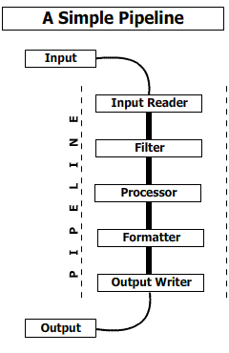
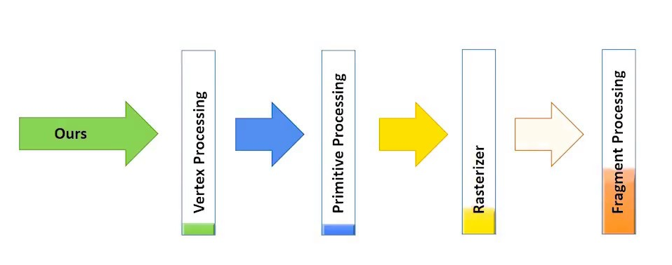
Pipeline Architecture
The pieces correspond to stages in the transformation of data in the system
Good for complex straight-line processes, e.g. image processing
Notes:
Pipelines are a third kind of architecture. Here, the pieces correspond to steps in the transformation of some data. Each piece depends on the data produced by the preceding piece.

Slide 39
Pipeline + Database
Stages in the pipeline share data through a database
database
Notes:
Pipelines are a third kind of architecture. Here, the pieces correspond to steps in the transformation of some data. Each piece depends on the data produced by the preceding piece.

Slide 40
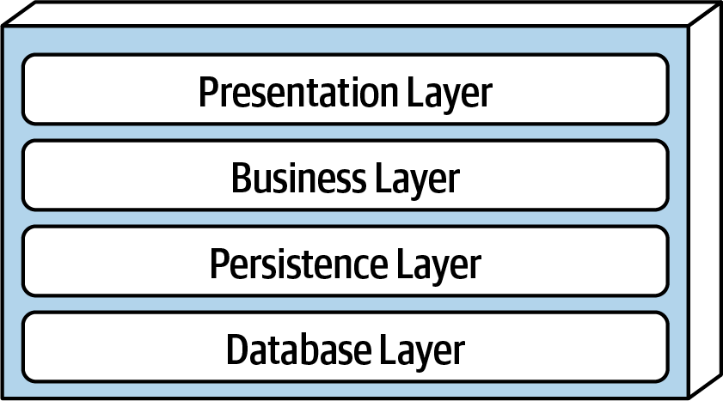
Layered Architecture
Request
Response
The pieces correspond to level of concern.
Each layer depends on services from the layer or layers below
Data/Control Flow
Notes:
Here is a layered architecture. In a layered architecture, the pieces correspond to levels of concern, where each layer depends on services from the layer or layers below. This is an example of “Separation of Concerns.” For example, the Presentation Layer depends only on the data supplied by the Business Layer; it does not have to concern itself with the details of how that data is computed.
One advantage of this architecture is that the different layers typically require different areas of expertise, so in a large project one might have separate teams for each layer.
Remember that each Layer may have its own internal architecture. For example, the Presentation Layer may itself be implemented using an object-oriented architecture.

Slide 41
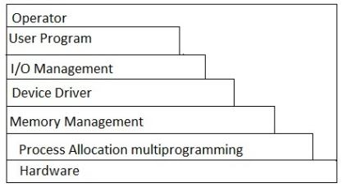
Layered Architecture (contd)
Typical organization for operating systems
Layers communicate through procedure calls and callbacks (sometimes called "up-calls")
Notes:
Layered architectures are very common in Operating Systems. You’ve probably seen pictures like this in your Operating Systems class.

Slide 42
Design at the Interaction Scale
Roughly what’s typically called “Design Patterns”
We’ll talk about some OO Design Patterns in the next lecture.
But we’ll see interaction-scale patterns in many domains, not just OOP.

